Slide 1
Showcasing our programmes for aid and development professionals
Find us at E26 in the Careers and Training Pavilion

Slide 2





Slide 3



Slide 4
Masters and short courses
Department of Social Policy and Social Work
York Law School
Post-war Reconstruction and Development Unit
Centre for Applied Human Rights

Slide 5
Online Masters of Public Administration - International Development
One of a range of online programmes in public policy and management:
  350 graduated with a Masters degree in last 10 years
  Currently 200+ students in 70 countries
Combines academic excellence with professional development orientation
Flexibility of online learning, with a clear structure and support of a dedicated programme team
Commonwealth Scholarship Commission funding – awarded last 5 years
http://www.york.ac.uk/spsw/onlinestudy/

Slide 6
Online MPA - International Development (2)
Programme aim is to develop practitioners’ capacity to influence and lead the development and aid agenda. Key themes include:
International development theory and practice – the social, political and economic dimensions of development
The international context of public administration – issues and challenges in global and state governance
Processes of public policy – factors that shape policy success or failure. Influencing policy decisions
Strategic capability – strategic planning, management of public finances, leadership and organisational learning
Contact: Dr Sally Brooks, Lecturer and Programme Director MPA-ID, Department of Social Policy and Social Work, University of York, UK. sally.brooks@york.ac.uk

Slide 7
York Law School
University of York
LLM in the theory and practice of clinical legal education

Slide 8
LLM in the ‘Clinic’
Unique – builds on PBL method used at YLS
Aims to develop knowledge, skills and values in experiential learning in the setting of live-client legal clinics
Designed to build capacity – on completion of the programme students should be able to help establish and run legal clinics in any country
Shaped by the need to meet educational best practice, professional standards of legal service and unmet legal needs

Slide 9
Students study:
Learning and teaching theory
Professional practice requirements
Client-centred lawyering
Access to justice and sustainable development
Jurisdiction-specific requirements
Supervision (casework and other students)

Slide 10
For more details or for a discussion about the programme and its aims please contact:
richard.grimes@york.ac.uk
Director of Clinical Programmes
York Law School

Slide 11

Interdisciplinary centre of excellence pioneering the study of – and responses to – conflict-affected countries, based at the University of York, UK.
TEACHING
Online MSc in International Humanitarian Affairs
MA and PhD in Post-War Recovery Studies
RESEARCH
Problem-solving focussed
Bridging international, national, and local perspectives
Engagement of communities as equal partners
Shaping policy & practice in disaster and conflict interventions
PRACTICE
Bespoke Continuing Professional Development courses (CPDs) offered in the UK and in the field
Consultancies
Monitoring and Evaluation

Slide 12
The MSc in International Humanitarian Affairs is unique as an interdisciplinary post-graduate programme offered exclusively online, delivered by the PRDU and the Overseas Development Institute’s Humanitarian Policy Group.
The MIHA provides a rigorous learning environment that cultivates the analytical and practical skills essential for professionals working in the humanitarian sector. The programme:
draws on the field experience of its lecturers and students working within humanitarian crises during the programme so that they are able to better understand, assess and construct effective responses at local, national and International levels;
    cultivates advanced research skills, and evidence-based decision making, policy, and practice;
develops and deepens critical understandings of the challenges, dilemmas and responses to humanitarian crises.

Slide 13
The Centre for Applied Human Rights
Online Postgraduate Certificate in Defending Human Rights;
professional development courses on Leadership, and International refugee law and advocacy; and
MA in Applied Human Rights and LLM in International Human Rights Law and Practice.

Slide 14
Postgraduate Certificate in Defending Human Rights
3 Modules
Wholly online; asynchronous activities
Modules can be taken separately as CPD
Modules:
  International Human Rights Law and Advocacy
  Working Safely: Managing Risk and Strengthening Protection
  Leading and Managing Effective Human Rights Organisations

Slide 15
Outcomes for students
develop practical skills in risk analysis, producing and using security plans, and maintaining digital security
apply strategies to increase organisational resilience, adaptability and sustainability in the face of adversity and external change.
incorporate rights-based approaches into programme activity and strategic planning
reflect on and develop your own practice of leadership and management

Slide 16
Leading and Managing Effective Human Rights Organisations
  Increasing security of HRDs at the organisational level
  helping human rights organisations increase their resilience, adaptability and sustainability in the face of adversity and external change.
  Key principles:
  Internally healthy and externally effective organisations
  Congruent organisations: creating rights cultures within organisations as well as within the society or system we are seeking to influence
  Globally responsible practice
  Developing the reflective practitioner

Slide 17
Leadership
The higher you are in an organisation, the more change is required of you personally. Those who have led their organisations into new ways often say that the most important change was personal. Nothing would have changed in their organisations if they hadn’t changed.
Wheatley, Margaret (2005) Finding Our Way

Slide 18
Leadership qualities are not the qualities that enable people to attract followers, but those that enable them to do without them. True leaders, in short, do not make people into followers, but into other leaders.
John Holt
Not the cry, but the flight of a wild duck, leads the flock to fly and follow.
Chinese proverb

Slide 19
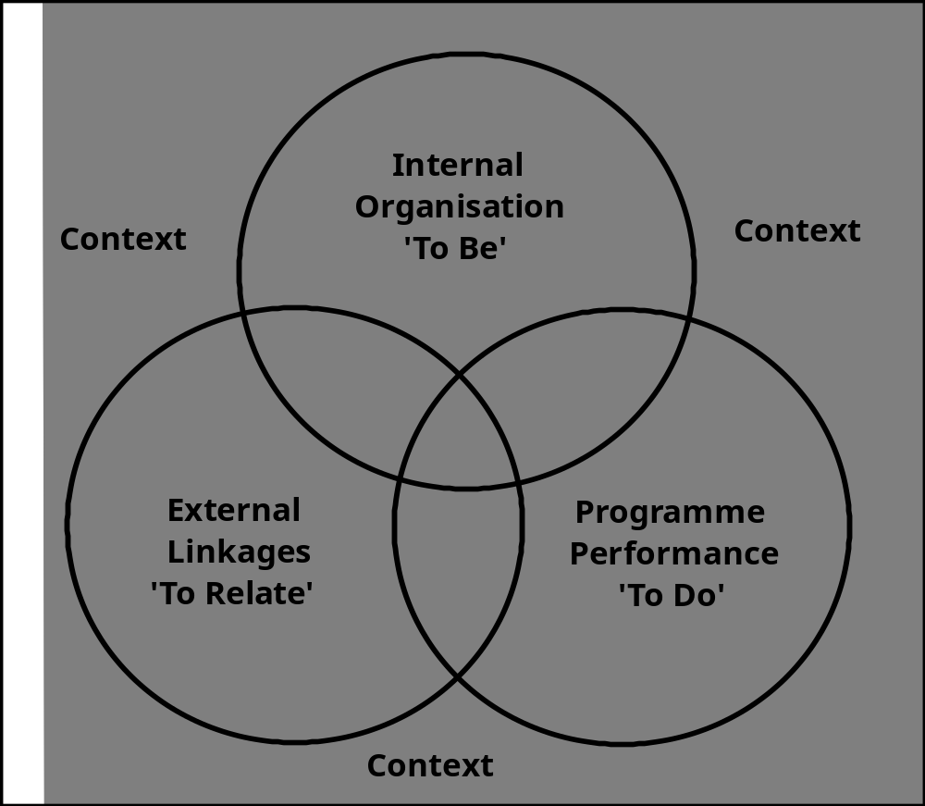
Organisational analysis
Intrac; Lipson & Hunt, 2008
Notes:
From Intrac, non-profit organisation
working in the international development and relief sector.
Supports non-governmental organisations and civil society organisations around the world by
exploring policy issues, and by strengthening management and organisational effectiveness.
Orgs are complex, organic and ever changing organisms
Social change organisations try to influence change in their environment – and are influenced by that environment
They can’t act in isolation; they have to invest in their relationships – with other CSO’s, government, donors, private sector; and do so nationally, regionally and internationally
IT’s helpful to think of a variety of elements – specific capacities – which enable the system – the organisation – to fulfil its purpose and function
Aim is to be resilient, strategic and non-dependent
When we look at an orgs capacity to be successful in its mission, understand the capacity in relation to:
The demands and pressures from the external environment – the context
The orgs’ programme performance – To do
Its internal functioning – to be
Its relationships – to relate
These overlap and interrelate. If an org has poor leadership or less obviously, its capacity to relate is poor, that will affect its performance
Likewise, there is a continuing interaction between the org and its surrounding context, each impacting on the other
To do or “programme” circle – the work that the org does. For example, human rights, health, poverty alleviation, education.
~This dimension includes a series of capacities related to project management; technical skills and knowledge expertise in the programme area; competencies in research and influencing policy etc
But to deliver its programme effectively, it has to have a strong vision of what it is striving for, based on core values, effective leadership, comprehensive strategy, appropriate internal systems, competent staff etc
These are some of the specific capacities of the second org dimension, the
Internal functions – the To be circle
These capacities relate to overall org performance and sustainability
In addition, CSO’s need to have positive helpful external relationships – the org needs to be able to relate. Can’t achieve change by working in isolation
Manage its relationships strategically, and staff be competent in skills such as negotiation and communication
There is a direct correlation between the quality of a CSO’s external relationships and its impact on development
The critical element in this model is the context or environment in which the CSO is operating. To analyse and improve an org’s capacity, you have to understand how the org interacts with the external context.
An org’s ability to understand its environment, interact easily with it, and anticipate and manage subsequent change – is a key capacity to adapt and survive

Slide 20
Phases of organisational development
Three phases of organisational development:
Pioneer – fluid, informal, family-feel
Differentiation – necessary order, separation, specialisation, greater formality
Integration – reawakening, a more conscious reorganisation, return of values, leadership and relevance to the outside world
Kaplan, A. (1996) The Development Practitioners’ Handbook

Slide 21
Governance models
Advisory board model
Patron model
Cooperative model
Management Team model
Policy board model
Fishel, D. (2003) Boards that Work

Slide 22
The Module also covers...
Project and programme management
Performance management
Fundraising and financial accountability
Creativity, innovation and the learning organisation

Slide 23
Programmes for aid and development professionals
Find us at E26 in the Careers and Training Pavilion
www.york.ac.uk

